Slide 1
Research by Shellone Reynolds
For: Professor Alison Lietzenmayer
COMM 305
09-27-2014

Slide 2
Research Project 1 Annotated Bibliography & Reflection

Slide 3
Highlights from Report created:
The purpose of this report was to compare the articles of Heeman (2007) and Omdall (2006) demonstrate an understanding of verbal and nonverbal communication in the workplace.
Also to further examine both the communication theory and practice of communication in a professional setting
as a crucial skill that can set me
aside from my peers and to
determine an answer to my
question and the problem of the article being:
Why hasn’t past and current interpersonal and relational content, interrelated in today’s research? A strong concluded was noted that delivery formats to combat bullying in the workplace needed to be clearly understood and communicated across the many lenses and personalities workplaces may encounter.

Slide 4
Heeman (2007) made a plea that the topic on workplace bullying should be observed, studied and needed to be identified definitively as a reaction based socialization from people intimidated and powerless.
Results learnt indicated the Taylor’s Theory of Scientific Management is in effect today as it was evident in this writing as the same non-conflict results were wanted regardless of individual efforts causing the conflict.
Also shown were the importance of the roles of interpersonal communication, small group, organizational, and mass media communications as it relates to the workplace for successful communication, rapport and satisfaction.
Clear Thesis
Learning Construct.
The study was also a practical research, in that it blended a theoretical
and problem-based research.

Slide 5
It has a theoretical component because it is ultimately aimed toward defining bullying. Heeman (2007) strategized a plea to give new insight from developing techniques about the same relationship problem, this was proof that continued research could be satisfying. A challenging statement noted, referred that a direct association of behaviors’ weren’t linkable to bullying.
Recommendations from
Heeman (2007) reading to
innovatively communicate
supported and complimented
the main points in Omdahl, (2006)
to prove the concept about
supportive insight of the following:
verbal and non-verbal cues; listening; social support and dialogue.
Next steps noted by Heeman (2007) pointed out serious events needed special attention from management and peers for example, a crisis needs to be communicated to promote organized strategies. One needed to be aware of an individual’s private turning points so that through collaboration, reconciliation could be achieved.
Reasoning and evidence strong

Slide 6
Type of Research
Prevention tactics were scarcely mentioned as the need to modeling good behavior, asking for feedback and penalizing rudeness weren’t noted. The focus of the article were about the effect, lacked detailed discussion about verbal and non-verbal commutative habits and didn’t address the underlying causes.
Examples of this were noted addressing the cost factor on losses as well as the lack of logical approaches from researchers. The information covered were also factual based on questionnaires and other record keeping methods shown and also opinionated as statements evolved from the interpretation of facts such as varying definitions.
Qualitative research that neglected control as part of their research in an attempt to observe the whole environment surrounding the research. The author observed how persons being bullied were affected by the situation.

Slide 7
Variables noted
The dependent variable noted in Heeman (2007) were that they looked at the amount of change of cycles in past and present occurrences'. The Bullying cycle was stated to be widespread across many types of organizations’, diverse cultures and in the international community.
This widespread effect were a perfect example of globalization at work as Lietzenmayer (2014) stated that individualistic cultures such as the USA are low-context, looks at self, versus group identity, likes to target solution of the problem rather than build relationships and values of autonomy, assertiveness and democracy. On the other hand as other countries have more collective cultures, they are high-context, value group membership, obligations, relationships, empathy and listening.
I do not recognize that there are any extraneous variables in this study.

Slide 8
Bias was evident as the article didn’t identify where bias was prevented by showing a proper study design, implementation and blind data collection. Even though literature and terminology used were systemic, listing resources used showed study cohorts of communication researchers to channel the bias. The topics explored in the article were controlled to give foundation to the development of a proper definition of bullying in the workplace, with a plea to be used by current researchers’.
Research design:
Bias
Control

Slide 9
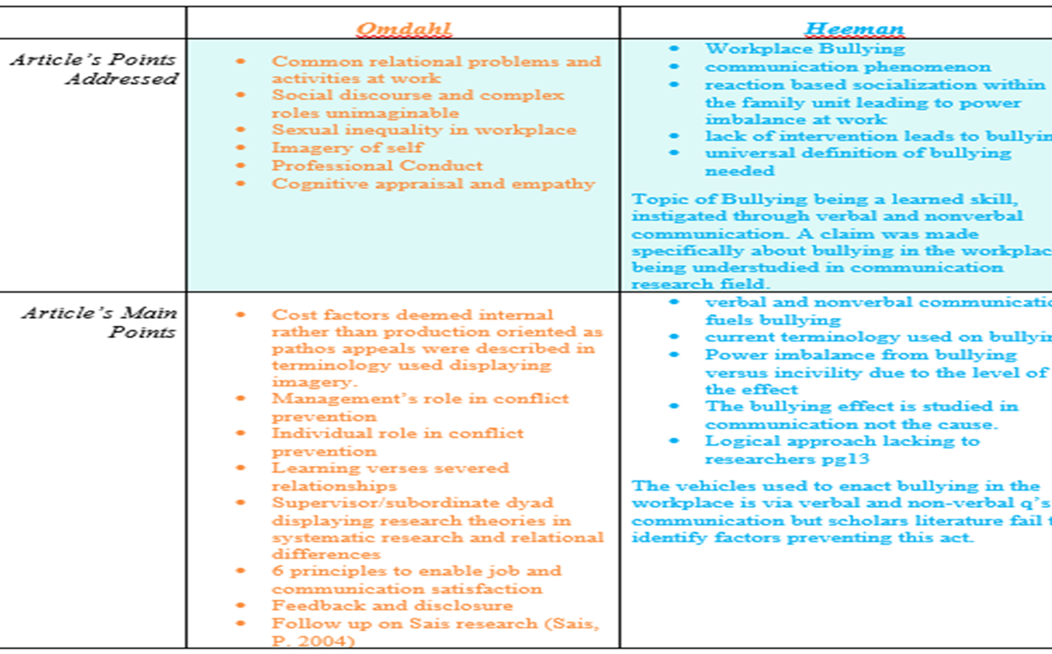
Research article comparison

Slide 10
References
Heeman, V. (2007). Workplace Bullying: A Distinct, Interpersonal, and Communicative Phenomenon. Paper presented at the meeting of the National Communication Association.
Lietzenmayer, A. (2014). Listening and Nonverbal Communication PowerPoint presentation [PDF document]. Retrieved from Lecture Notes Online Web site: http://ple.odu.edu/courses/201410/comm305/uuid/ba92f7a88c1de9cf08e1613b6f69ba5c2448c903 82623426455a15c74344735aab57b145
Omdahl, B. L. (2006). Towards effective work relationships. Problematic relationships in the workplace, (pp. 279-294). New York: Peter Lang
Sias, P. M. (2004). Disengaging from workplace relationships. Human Communication Research, 30(4), 589- 602.

Slide 11
http://www.sagepub.com/eic/14/Chapter14_Critique1.pdf

